Slide 1
Python
Session – 14
Date – 15th June, 2022

Slide 2
Iterators

Slide 3
What is Iteration?
One of the most essential principles of software development is that Don’t Repeat Yourself.
One specific application of the above-mentioned principle in modern programming is the use of Iteration that involves going over a list of items, on which we performed the defined operation. One of the most basic forms of iteration is a for loop.
Iteration means ‘repeating steps’ in layman’s language.
In Programming, Iteration is defined as a repetition of a block of code a specified number of times.
To achieve the iterations, we can use loops such as for loop, etc.

Slide 4
What are Iterables?
Iterables are objects that can be iterated in iterations.
Iterable is an object which can be looped over or iterated over with the help of a for loop.
Objects like lists, tuples, sets, dictionaries, strings, etc. are called iterables. In short and simpler terms, iterable is anything that you can loop over.
In simpler words, iterable is a container that has data or values and we perform an iteration over it to get elements one by one. (Can traverse through all the given values one by one)
Iterable has an in-built dunder method __iter__.

Slide 5
How we can check whether an object is Iterable or not?
An object is called an iterable if you can get an iterator out of it.
A simpler way to determine whether an object is iterable is to check if it supports __iter__. How? Here we use the function named dir( ), which returns the list of attributes and methods supported by an object, and by seeing all attributes and methods, we can find all and select required methods from them.
Calling iter() function on an iterable gives us an iterator.
Calling the next() function on iterator gives us the next element.
If the iterator is exhausted(if it has no more elements), calling next() raises the StopIteration exception.

Slide 6
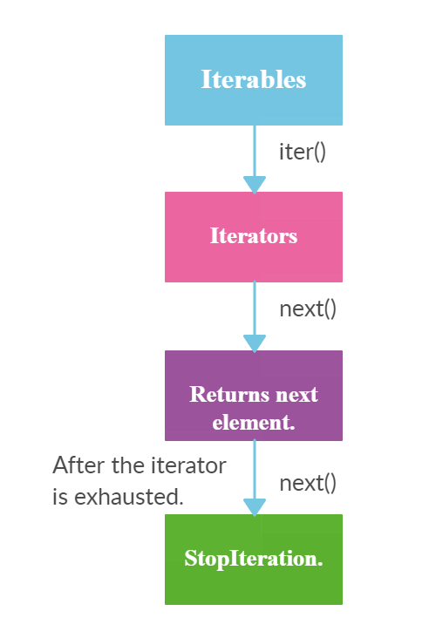
How we can check whether an object is Iterable or not?

Slide 7
How we can check whether an object is Iterable or not?
For Example,
# String as an iterable
for i in ‘python':
print(i)
print('-----')
# list as an iterable
for i in [1, 2, 3]:
print(str(i*2))

Slide 8
What are Python Iterators?
An Iterator is an object representing a stream of data that produces a data value at a time using the __next__() method.
In Python, an iterator is an object which implements the iterator protocol, which means it consists of the methods such as __iter__() and __next__().
An iterator is an iterable object with a state so it remembers where it is during iteration. For Example, Generator
These iterators give or return the data one element at a time.
It performs the iteration to access the elements of the iterable one by one. As it maintains the internal state of elements, the iterator knows how to get the next value.

Slide 9
Which in-built methods does iterator have?
Iterator supports in-built dunder methods such as __iter__ and __next__
Iterators can only move forward using __next__. But remember that, iterators cannot go back or cannot be reset.
To learn more about the dunder methods in Python, refer to the link
The __next__ function:
The __next__() method takes no arguments and always returns the next element of the stream.
If there are no more elements in the stream, __next__() must raise the StopIteration exception.
Iterators don’t have to be finite. It’s perfectly reasonable to write an iterator that produces an infinite stream of data.

Slide 10
Which in-built methods does iterator have?
For Example,
number_iterator = iter([1, 2, 3, 4, 5])
print(type(number_iterator))
print(next(number_iterator))
print(next(number_iterator))
print(next(number_iterator))
print(next(number_iterator))
print(next(number_iterator))
# Once the iterator is exhausted, next() function raise StopIteration.
print(next(number_iterator))

Slide 11
Why should you use Iterators?
In modern days, we have a lot of data in our hands, and handling this huge amount of data creates problems for everyone who wants to do some sort of analysis with that data.
Therefore, Rather than putting all the data in the memory in one step, it would be better if we could work with it in bits or some small chunks, dealing with only that data that is required at that moment, right? As a result, this would reduce the load on our computer memory tremendously. And this is what exactly the iterators do!
Therefore, you can use Iterators to save a ton of memory, as Iterators don’t compute their items when they are generated, but only when they are called upon.

Slide 12
Relationship between Iterators and Iterables
The first thing we have to note is that “Iterators are Iterables”, and if we use the iterator in a for loop, then it will still work.
The opposite is not always true. For example, iterables like strings and lists are not iterators such that they don’t have the next() method.
Now, as shown in the below example, we use the same iterable (i.e., a list) in two for loops without getting any errors. By contrast, the iterator can be used just once, as completing the first for loop has already made the iterator iterate all elements such that no more elements to be iterated.
# Use iterables in for-loops for multiple times
number_iterable = [1, 2, 3]
for i in number_iterable:
print(i)
print('-----')
for i in number_iterable:
print(i)
print('-----')
# Use iterators in for-loops for multiple times
number_iterator = iter([1, 2, 3])
for i in number_iterator:
print(i)
print('-----')
for i in number_iterator:
print(i)
# nothing is printed

Slide 13
Difference between Iterables and Iterators
Iterables
Can be iterated using for loop.
Iterables support iter() function.
Iterables are not Iterators.
Iterators
Can be iterated using for loop.
Iterators suppports iter() and next() function.
Iterators are also Iterables.

Slide 14
1. Both iterables and iterators can be iterated using for loop.
list_1 = [1,2,3,4,5]
list_2 = iter(list_1)
print (list_2)
# Iterating through iterable(list_1) using for loop.
for element in list_1:
print (element,end=" ")
print (" ")
# Iterating through iterator(list_2) using for loop.
for element in list_2:
print (element,end=" ")

Slide 15
2. Iterables supports only iter() function. But iterators supports both iter() and next() function.
Iterable:
list_1 = [1, 2, 3, 4, 5]
list_2 = iter(list_1)
print("\nFunctions inside iterables - ")
print(dir(list_1))
Iterable supports only iter() function
Iterator:
print("Functions inside iterators - ")
print(dir(list_2))
Iterator supports iter() and next() function.

Slide 16
3. Iterators are also Iterables.
We can get an iterator from an iterable by calling iter() function. Similarly, we can call iter() function on the iterator itself. Then, it will return the iterator object itself.
list_1 = [1,2,3,4,5]
# Returns an iterator
list_2 = iter(list_1)
print (list_2)
# Calling iter() function on iterator itself.
list_3 = iter(list_2)
print (list_3)
print (list_2 == list_3)

Slide 17
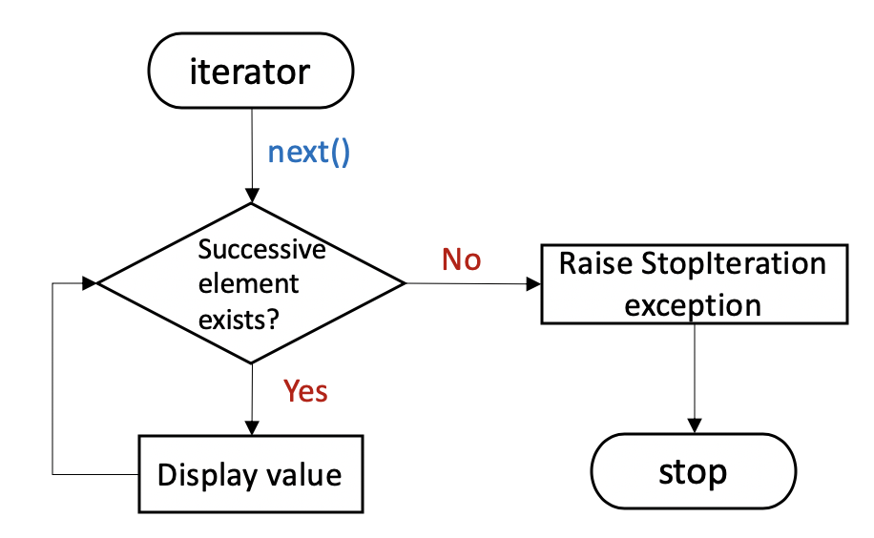

Slide 18
Limits of Iterator
We can only go forward in an iterator.
We can’t make a copy of it.
No way to get the previous element.
We can’t reset the iterator.
The iterator protocol only specifies the __next__() method. Therefore, Functions may consume all of the output of the iterator’s and if you need to do something different with the same stream, then you will have to create a new iterator to work with.

Slide 19
Infinite Iterators in Python
Iterator in Python is any python type that can be used with a ‘for in loop’. Python lists, tuples, dictionaries, and sets are all examples of inbuilt iterators. But it is not necessary that an iterator object has to exhaust, sometimes it can be infinite. Such type of iterators are known as Infinite iterators.
Python provides three types of infinite iterators –
1. count(start, step): This iterator starts printing from the “start” number and prints infinitely. If steps are mentioned, the numbers are skipped else step is 1 by default. See the below example for its use with for in loop.
Example:
import itertools
for i in itertools.count(5, 5):
if i == 35:
break
else:
print(i, end =" ")

Slide 20
Infinite Iterators in Python
2. cycle(iterable): This iterator prints all values in order from the passed container. It restarts printing from beginning again when all elements are printed in a cyclic manner.
Example #1:
import itertools
count = 0
# for in loop
for i in itertools.cycle(‘ABC'):
if count > 7:
break
else:
print(i, end = " ")
count += 1

Slide 21
Infinite Iterators in Python
Example #2: Using next function.
import itertools
l = [‘Python', ‘Java’, ‘C++’]
# defining iterator
iterators = itertools.cycle(l)
# for in loop
for i in range(6):
# Using next function
print(next(iterators), end = " ")

Slide 22
Infinite Iterators in Python
3. repeat(val, num): This iterator repeatedly prints the passed value infinite number of times. If the optional keyword num is mentioned, then it repeatedly prints num number of times.
Example:
import itertools
# using repeat() to repeatedly print number
print ("Printing the numbers repeatedly : ")
print (list(itertools.repeat(10, 4)))
Check Out the following link for more info on functions –
itertools — Functions creating iterators for efficient looping — Python 3.10.5 documentation

